Slide 1
Market Skills Demand Analysis
17-05-2022
Lucky KAKPO & Grzegorz PRZESNIAK

Slide 2
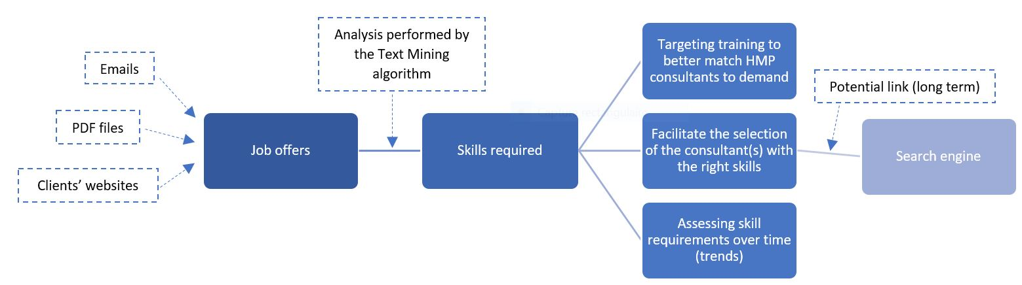
Objectives
Goal: Gain more knowledge about the data skills requested on the Belgian market to identify trends
and target training

Slide 3
Roadmap
LinkedIn Data Offers Analysis
Analysis of HMP Clients’ Data Offers
Gain insight into the data market
Understand HMP clients’ requirements
Creation of a theoretical foundation
Validation of Graphene support
Develop a web scraping algorithm
Visualization of the information collected
Test the algorithm on internal offers
Develop a text mining algorithm
Adapt the algorithm to other practices
Improve decision making

Slide 4
Added value for Headmind Partners Belgium
Opportunities for BDs
Gain knowledge about the Belgian market
Increased efficiency in reading job offers
Collaboration with Graphene
First project in common
Knowledge sharing in Data Science
Additional knowledge & skills
Gain additional skills in Text Mining, Python & Web scraping
Competences that can be used for future missions

Slide 5
Thank you!
Any questions?

Slide 6
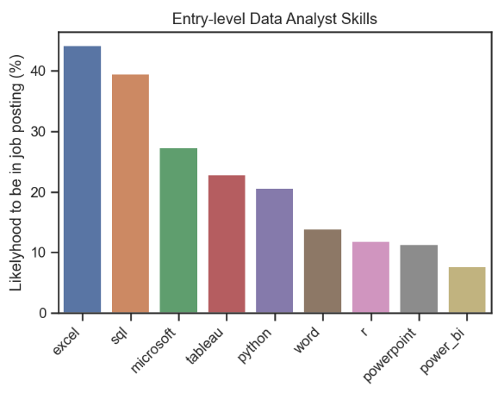
Example of final visualisation
This graph shows, for Entry-level Data Analyst position, the frequency of each technical skill among 4525 jobs scrapped from LinkedIn in 24 hours.
The conclusion is that the three most in-demand skills on that day were Excel, SQL, Tableau.
Source: LinkedIn jobs analysis in USA, by Luke Barousse

